Slide 1
Datamining CSE2525
Nov 11, 2024
Notes:
YOU ARE NOT SUPPOSED TO SEE THIS!
Turn on your cameras
Second year on campus
Start recording

Slide 2


Slide 3
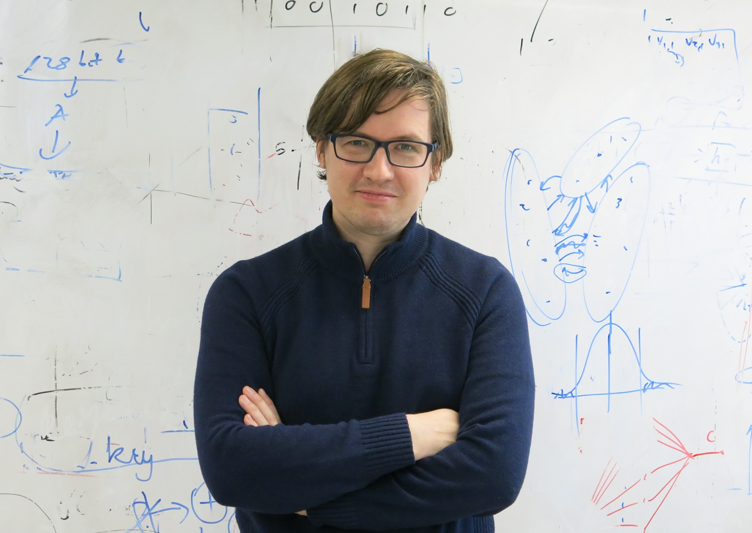
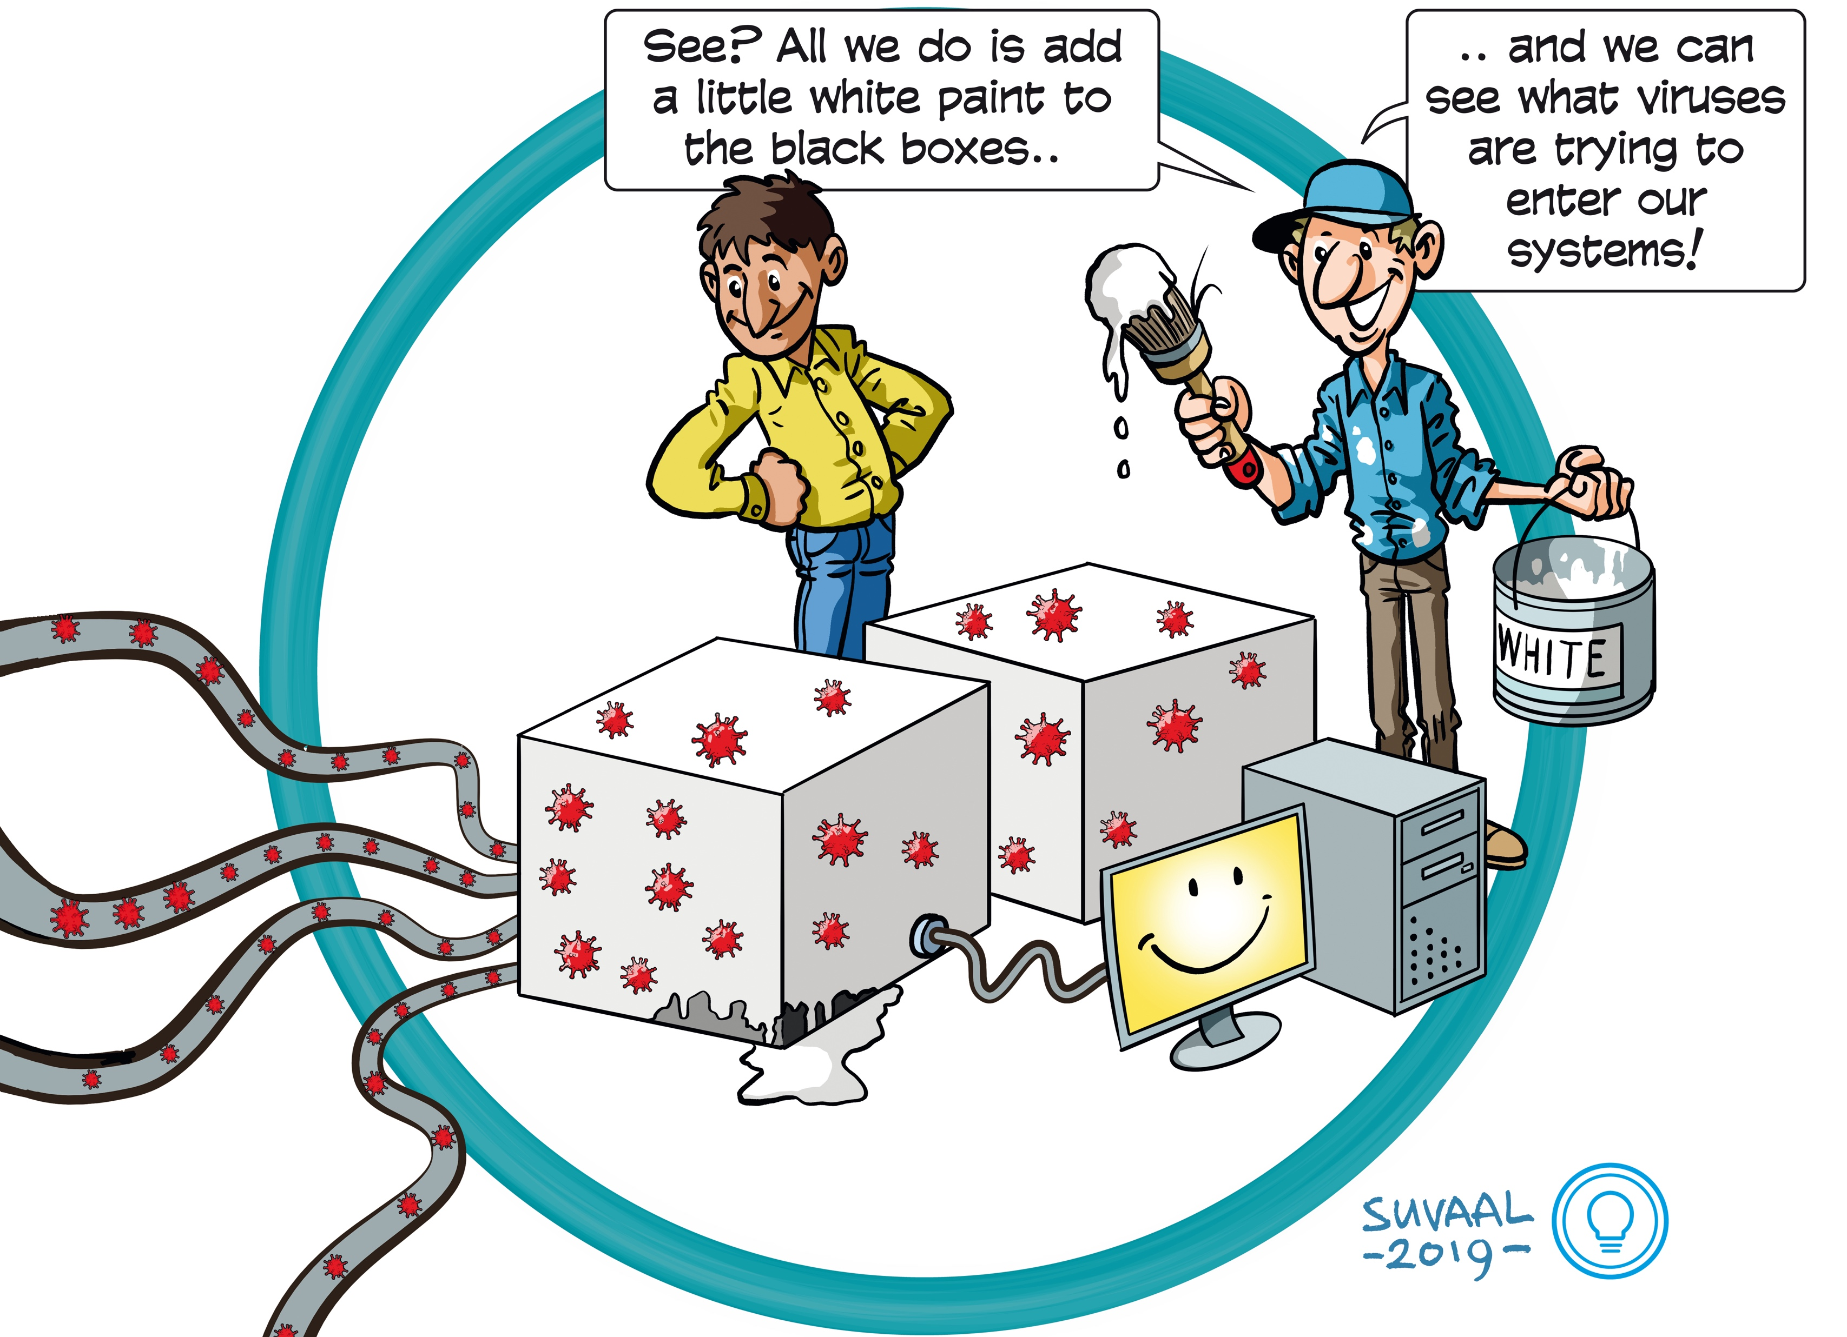
Sicco Verwer
Associate professor in Algorithms
Research:
algorithm design for learning interpretable models
applications in cyber security
awards: Veni, Vidi grants, Test-of-Time award
Teaching:
cyber data analytics
AI for software reverse engineering
data mining
Optimization for ML
https://cyber-analytics.nl/

Slide 4
Avishek Anand
Associate Professor at the Web Information Systems (ST)
Topics: Information retrieval, NLP, Explainable AI
Teaching: Information Retrieval, NLP, Data mining
Topics covered in this course
Text Data Mining
How do we mine massive collections of text data ?
Word embeddings, indexing text
Graph data mining
How do we mine large graphs ?
Graph embeddings, graph analysis
Notes:
Different from SQL

Slide 5

Nergis Tömen
Assistant Professor at Intelligent Systems (INSY)
Topics: Biologically-inspired machine vision, neuromorphic computing
Labs: Computer Vision Lab (member) Biomorphic Intelligence Lab (director) Biomedical Intervention Optimisation Lab (director)
Teaching:
(MSc) Seminar Computer Vision by Deep Learning
(MSc) Machine Learning 2
(BSc) Data Mining
Topics covered in this course:
Matrices, PCA, Matrix decomposition, Recommender systems
Notes:
Different from SQL

Slide 6
Today's goals
Course goals
Course logistics
Course content overview
What data mining is all about
A word of caution

Slide 7
Course goals
In this course you learn about Data Mining:
Several key algorithms, you must know:
How to implement them
Their strengths and weaknesses in practice
Why and when to use these in practice
Core concepts:
What they are – including theory –
Which concepts exist for different data types
Practical skills:
What concept to use for a given problem
How to succesfully apply algorithms in practice
Notes:
What we will cover total
Course logistics
Course content overview
Disclaimer and warning label
Some first formulas to warm up

Slide 8
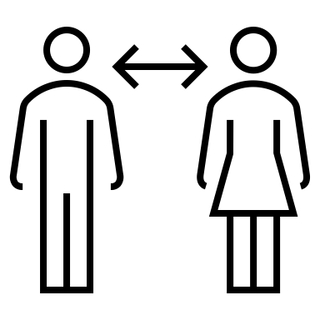


Three Verticals
Distances
Matrices
Counting
Notes:
What we will cover total
Course logistics
Course content overview
Disclaimer and warning label
Some first formulas to warm up

Slide 9
Schedule | Week | Day | Date | Time | Topic | Lab Assignment Deadline
Lecture 1 | 2.1 | Mon | Nov 11 | 13:45-15:45 | Introduction | Lab 1: Anomaly detection
Lecture 2 | 2.1 | Thu | Nov 14 | 10:45-12:45 | Anomaly detection (DTW for Lab 1)
Lecture 3 | 2.2 | Mon | Nov 18 | 13:45-15:45 | Distances (use case discussion)
Lecture 4 | 2.2 | Thu | Nov 21 | 10:45-12:45 | Matrices (PCA for Lab 1)
Lecture 5 | 2.3 | Mon | Nov 25 | 13:45-15:45 | Embeddings
Lecture 6 | 2.3 | Thu | Nov 28 | 10:45-12:45 | Clustering (for Lab 2) | Lab 1 due date
Lecture 7 | 2.4 | Mon | Dec 2 | 13:45-15:45 | Discrimination (discussion) | Lab 2: Graph Clustering
Lecture 8 | 2.4 | Thu | Dec 5 | 10:45-12:45 | Invited lecture?
Lecture 9 | 2.5 | Wed | Dec 11 | 13:45-15:45 | Graph Mining
Lecture 10 | 2.5 | Thu | Dec 12 | 10:45-12:45 | MinHashing (for Lab 3)
Lecture 11 | 2.6 | Mon | Dec 16 | 13:45-15:45 | Indexing
Lecture 12 | 2.6 | Thu | Dec 19 | 10:45-12:45 | Sketching | Lab 2 due date
Lecture 13 | 2.7 | Mon | Jan 6 | 13:45-15:45 | NMF (for Lab 3) | Lab 3: Hashing/NMF
Lecture 14 | 2.7 | Thu | Jan 9 | 10:45-12:45 | Recommender systems (for Lab 3)
Lecture 15 | 2.8 | Mon | Jan 13 | 13:45-15:45 | Manifold learning
Lecture 16 | 2.8 | Thu | Jan 16 | 10:45-12:45 | Data Visualization (discussion)
Lecture 17 | 2.9 | Mon | Jan 20 | 13:45-15:45 | Exam summary slides/Q&A
Lecture 18 | 2.9 | Thu | Jan 23 | 10:45-12:45 | Mock exam answers/Q&A | Lab 3 due date
Exam | 2.10 | Mon | Jan 27 | 13:30-16:30 | Weblab exam

Slide 10
Teaching methods
Lectures: 18
13 content lectures
2 invited lectures
1 Intro
2 Q&A
Labs: 3
Homework Assignments: 6
Notes:
For the video lectures there is about 2-3 hours worth of video material, so start early enough

Slide 11
Lecture schedule
Complete schedule: on Brightspace
Older lectures are recorded as backup at Collegerama that will be used sometimes in the flipped classroom
E.g. On 24.11. - The lecture on distances will be flipped
What is a flipped classroom ?
Please watch the video in Collegerama before come to class
In the lecture we do case studies – how do you apply what you have learnt in real-world scenarios ?

Slide 12
Course material
Required - Brightspace:
Lecture slides (after each class)
Lab exercises (beginning of the week)
Reading materials (book chapters and selected papers)
Content from 2 books:
Mining of Massive Datasets
Data Mining
Both are fully available through the TU Delft digital library!
Selected Chapters will be uploaded to Brightspace

Slide 13
Lab sessions
Mandatory
3 topics
9 sessions
Lab sessions on Friday afternoon
Assistance and feedback at lab session
Queue (https://queue.tudelft.nl/requests)
Mattermost (https://mattermost.tudelft.nl/)
Answers EWI with tag CSE2525 (https://answers.ewi.tudelft.nl/)
Kaggle (https://www.kaggle.com)
Weblab (https://weblab.tudelft.nl/)
Peer (https://peer.tudelft.nl/)
Make sure you have a recent version of Python, including Numpy, Scipy, Pandas, Seaborn, Matplotlib on your own computer!
Notes:
mention online solutions
mention goals: facilitate learning

Slide 14
Lab sessions
Please, do not use e-mail!
They will not be answered.
Mandatory
3 topics
9 sessions
Lab sessions on Friday afternoon
Assistance and feedback at lab session
Queue (https://queue.tudelft.nl/requests)
Mattermost (https://mattermost.tudelft.nl/)
Answers EWI with tag CSE2525 (https://answers.ewi.tudelft.nl/)
Kaggle (https://www.kaggle.com)
Weblab (https://weblab.tudelft.nl/)
Peer (https://peer.tudelft.nl/)
Make sure you have a recent version of Python, including Numpy, Scipy, Pandas, Seaborn, Matplotlib on your own computer!
Notes:
mention online solutions
mention goals: facilitate learning

Slide 15
Lab sessions
3 topics
Each lab topic has three components
Algorithm implementation: Distances, Matrices, Counting
Building a pipeline: Data transformation, analysis, and visualization
Kaggle competition [Bonus Points]
Example - Topic 1 (this Friday): Anomaly detection
Algorithms to be implemented – DTW, PCA
Build an anomaly detection pipeline and evaluate its performance
Kaggle competition
Labs in student pairs! Pair up as soon as possible, and register on Brightspace.
Notes:
mention online solutions
mention goals: facilitate learning

Slide 16

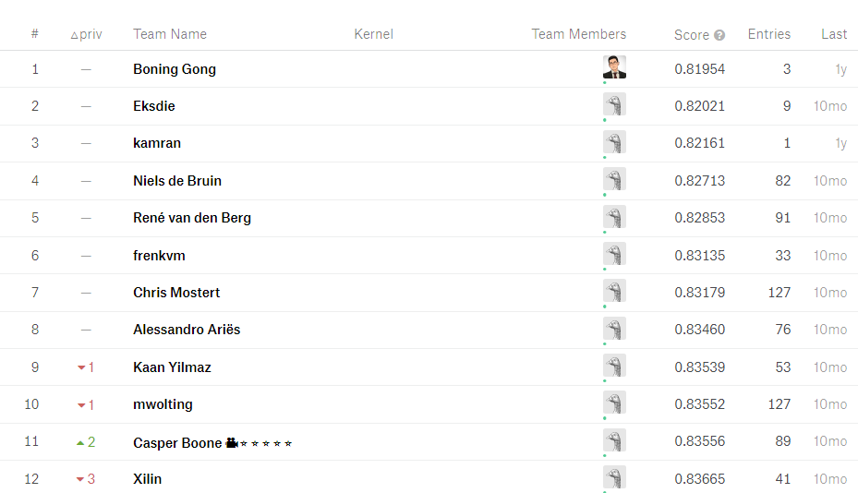

Slide 17
Lab Evaluation
Lab Evaluation – 30% of your final grade
Automatic evaluation of the algorithmic component
Peer review of the pipeline component
Please do your peer reviews, penalty if not completed
Your submissions will get 4 reviews
We will double-check the quality of the reviews
https://peer.tudelft.nl/courses

Slide 18
Lab Evaluation
Lab Evaluation – 30% of your final grade
Automatic evaluation of the algorithmic component
Peer review of the pipeline component
Kaggle competition – should beat our baselines to get bonus points
No solutions! Ask for help during labs.
Top 3 Kaggle submissions will be shared and asked to present

Slide 19
Lab Evaluation
No scikitlearn or other ML tool will be used, evertyhing is build from scratch!
Lab Evaluation – 30% of your final grade
Automatic evaluation of the algorithmic component
Peer review of the pipeline component
Kaggle competition – should beat our baselines to get bonus points
No solutions! Ask for help during labs.
Top 3 Kaggle submissions will be shared and asked to present

Slide 20

How does Peer Review work ?

Slide 21
Homework Assignments
6 of them
Idea: Mostly descriptive questions and problems
Reflects the type and hardness of questions you can expect in the final exam
Solutions will be given
NOT be graded or discussed in the lab

Slide 22
Final Exam
No (partial) transfer from previous years
WebLab (https://weblab.tudelft.nl) exam: 70%
One resit
Wednesday Jan 31, 2024
Weblab exam (Osiris + weblab registration)
Open and multiple-choice questions
No programming questions this year!
Closed book – calculator is allowed
*https://mytimetable.tudelft.nl is authoritative
Notes:
If we mess up due to too many students, too little capacity we typically add 1 week to the deadline
Externality The defendant must have nothing to do with the event's happening.
Unpredictability If the event could be foreseen, the defendant is obligated to have prepared for it.^{[9]} Being unprepared for a foreseeable event leaves the defendant culpable. This standard is very strictly applied:CE 9 April 1962, "Chais d’Armagnac": The Council of State adjudged that, since a flood had occurred 69 years before the one that caused the damage at issue, the latter flood was predictable.
Administrative Court of Grenoble, 19 June 1974, "Dame Bosvy": An avalanche was judged to be predictable since another had occurred around 50 years before.
3. Irresistibility The consequences of the event must have been unpreventable.
Examples: war, invasion, hurricanes, floods, fire, civil war, rebellion, revolution, terrrorist activities, lockout, interruption of electricity or communications

Slide 23
Course changes
We planned to remove 25% of the older content
Removed content:
Graph cuts
Community detection
New content:
High-dim data visualization

Slide 24
Expected prior knowledge
Discrete mathematics:
sets, intersections, and unions
Linear algebra:
matrix multiplication, projections, eigenanalysis
Probability and statistics:
Gaussians, correlation, covariance
Graph theory:
adjacency matrix, degree, clique, bipartite graph, shortest path
Data structures:
hash tables and indexes
Programming:
Python programming skills
Machine learning:
basic algorithms: logistic regression, random forest, svm, …

Slide 25
Prior courses
CSE1100/TI1206 Object-oriented programming CSE1305/TI1316 Algorithms and Data Structures CSE1200/TI1106M Calculus CSE1205/TI1206M Linear Algebra CSE1210/TI2216M Probability Theory and Statistics
CSE2510 Machine Learning CSE2520/TI2736-B Big Data Processing
Information only - not enforced
You are responsible for your study success!

Slide 26
Feedback
When:
Any time
How:
E-mail: dm-cs-ewi@tudelft.nl
Anonymous evaluations (EvaSys/EvaTool)
Notes:
Talk about dual role of administrator/teacher
I will ask at specific points in the lectures

Slide 27
Logistics summary
Optional practicals
Questions through online tools and at sessions
3 mandatory Labs – peer review + automated tests + kaggle
Closed-book Exam
Only for feedback:
dm-cs-ewi@tudelft.nl

Slide 28


Slide 29
What is Data Mining?

Slide 30
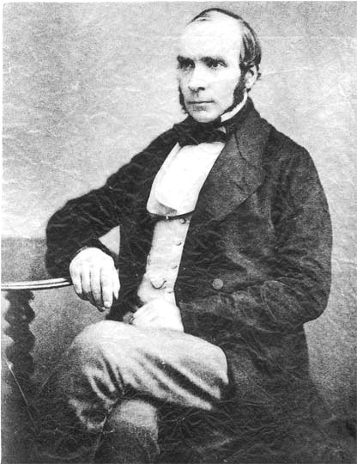
What is data mining?
The first data miner?
John Snow (1813-1858)
Plotted cholera cases on a map of London

Slide 31
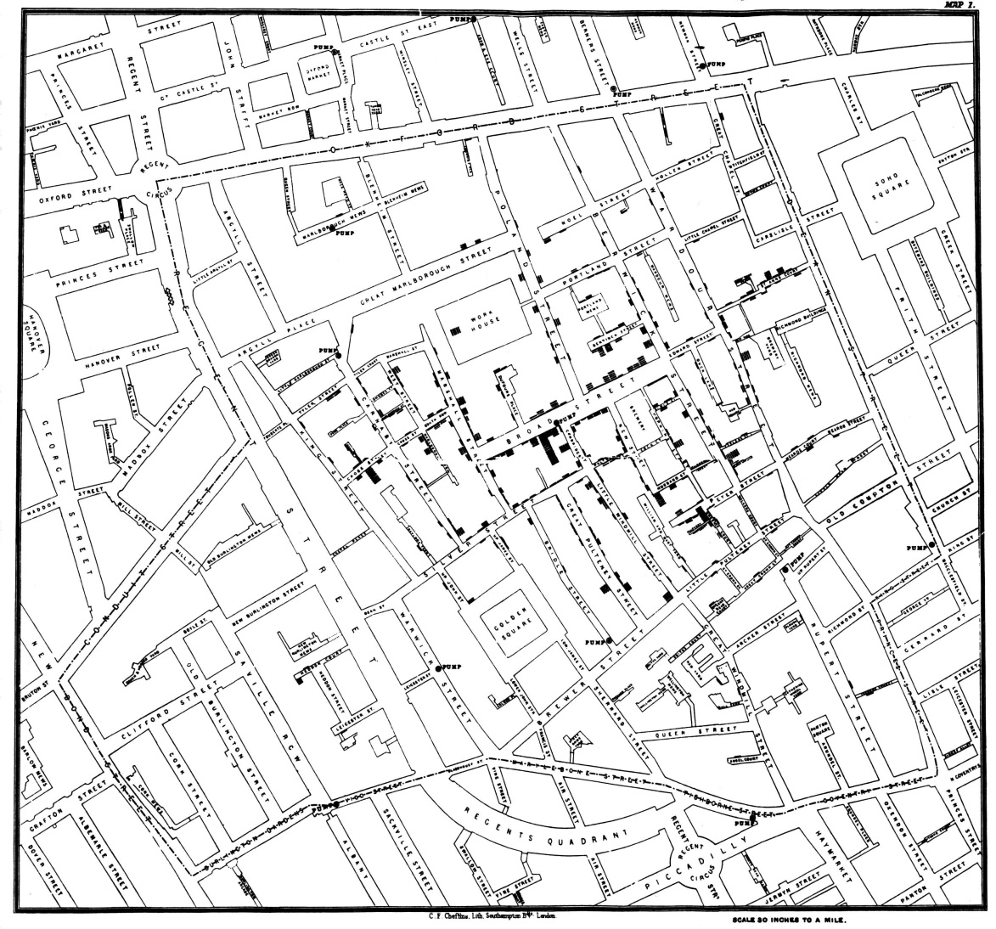
§

Slide 32


Slide 33
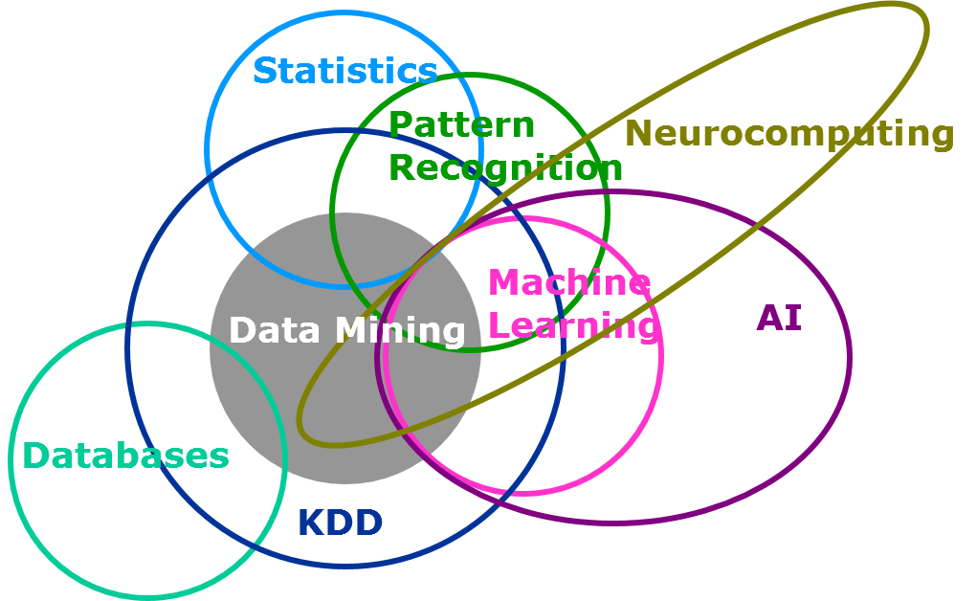
Data mining in context
http://blogs.sas.com
Notes:
http://blogs.sas.com/content/subconsciousmusings/files/2014/08/data-mining-Venn-diagram.png
Algorithm vs. applying algorithms, choosing from pool of methods vs. making own methods to extract knowledge, human involved vs. automated,
Data mining is applied machine learning
Statistics concerns probabilistic models, specifically inference of these models using data.
Machine Learning is concerned with predicting a particular outcome given some data. Almost any reasonable machine learning method can be formulated as a formal probabilistic model. Differs in that it generally doesn't care about parameter estimates, focus on computational efficiency and large datasets.
Data Mining is applied machine learning. It focuses more on the practical aspects of deploying machine learning algorithms on large datasets.
Artificial Intelligence is anything that is concerned with (some arbitrary definition of) intelligence in computers. So, a lot of things.

Slide 34
What is data mining?
“..is the process of searching and analyzing a large batch of raw data in order to identify patterns and extract useful information”
"...is the development of models for data in order to extract information from that data.”
"... is the process of analyzing data from different perspectives and summarizing it into useful information.”
".. is done by humans”
Notes:
New information: often takes the form of a model
Feature extraction: frequent itemsset (set of items that people buy together, like hamburgers and ketchup), similar items (amazon customers that buy similar items)
Summarizing (summarize importance of a page in one number, clustering of points that are close in space)
Algorithm vs. applying algorithms, choosing from pool of methods vs. making own methods to extract knowledge, human involved vs. automated,
Data mining is applied machine learning

Slide 35
What is data mining?
The primary goal of data mining is to extract useful information from a large volume of data and transform it into an understandable structure for further use.
Notes:
New information: often takes the form of a model
Feature extraction: frequent itemsset (set of items that people buy together, like hamburgers and ketchup), similar items (amazon customers that buy similar items)
Summarizing (summarize importance of a page in one number, clustering of points that are close in space)
Algorithm vs. applying algorithms, choosing from pool of methods vs. making own methods to extract knowledge, human involved vs. automated,
Data mining is applied machine learning

Slide 36
Data Mining vs. Machine learning vs Data Management
test data
Data Management
Data
Mining
learning
algorithm
model
train data

Slide 37
Data Mining vs. Machine learning
Classic ML Approach:
take a huge data set
compute features
train a classifier
deploy the classifier on test
test data
learning
algorithm
model
train data
output

Slide 38
Data Mining vs. Machine learning
Classic ML Approach:
take a huge data set
compute features
train a classifier
deploy the classifier on test
test data
learning
algorithm
model
train data
Data Mining is focussed on the ORANGE parts:
What to do with input and output?
output

Slide 39
Data Mining vs. Machine learning
Classic ML Approach:
take a huge data set
compute features
train a classifier
deploy the classifier on test
test data
learning
algorithm
model
train data
Data Mining is focussed on the ORANGE parts:
What to do with input and output?
output
For the BLUE parts we do care:
What algorithm to use and how to run it on our data?

Slide 40
Data Mining: Healthcare system
Objective: To find/uncover patterns and correlations in patient data
Process: The system analyzes a vast database of patient records, including symptoms, diagnostics, treatments, and outcomes.
Data mining techniques: clustering, association rule mining, and anomaly detection
Outcome: The system identifies patterns such as common symptoms associated with particular diseases, effective treatments for specific conditions, and any anomalies like rare side effects of treatments
Patients with a certain combination of symptoms (e.g., fever, cough, and shortness of breath) often test positive for a specific respiratory illness.

Slide 41
ML: Healthcare system
Objective: To predict diagnoses and recommend treatments for new patients based on the patterns identified.
Process:
Patterns and correlations discovered during the data mining phase are used to train ML models
Outcome: When new patient data is entered, the machine learning model can predict possible diagnoses and suggest the most effective treatment plans.
When a new patient presents symptoms similar to those identified in the data mining phase, the ML system assesses the probability of various illnesses and suggests potential treatment plans based on historical treatment success rates.

Slide 42

Healthcare System
test data
Data Management
Data
Mining
learning
algorithm
model
train data
output
patients

Slide 43
Healthcare System
test data
Data Management
Data
Mining
learning
algorithm
model
train data
output
patients

Slide 44
Often learning is unsupervised
learning
algorithm
model
train data

Slide 45
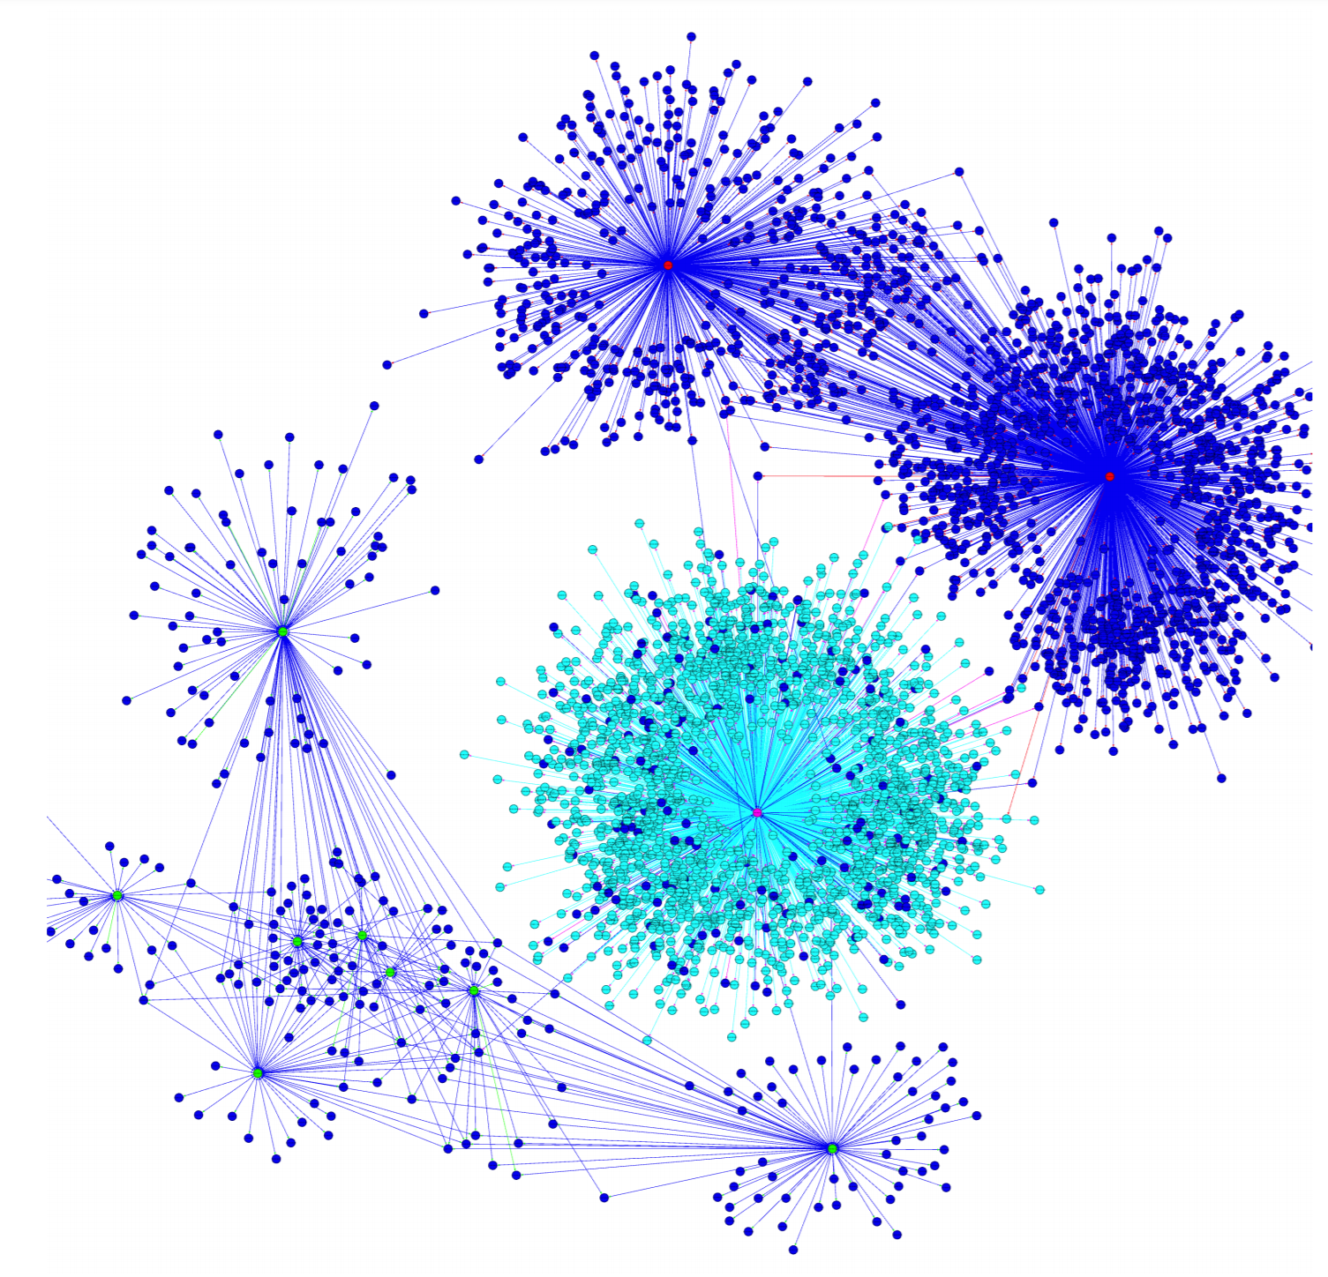
Example: Network/Graph data
Beyond Labeling: Using Clustering to Build Network Behavioral Profiles of Malware Families. Azqa Nadeem, Christian Hammerschmidt,
Carlos H. Ganan, Sicco Verwer. In Malware Analysis using Artificial Intelligence and Deep Learning, Springer, 2020. (Forthcoming)
Hybrid Connection and Host Clustering for Community Detection in Spatial-temporal Network Data. Mark Patrick Roeling, Azqa Nadeem, Sicco Verwer. In Machine Learning for Cybersecurity (MLCS), 2020

Slide 46
Community detection
learning
algorithm
model
train data

Slide 47
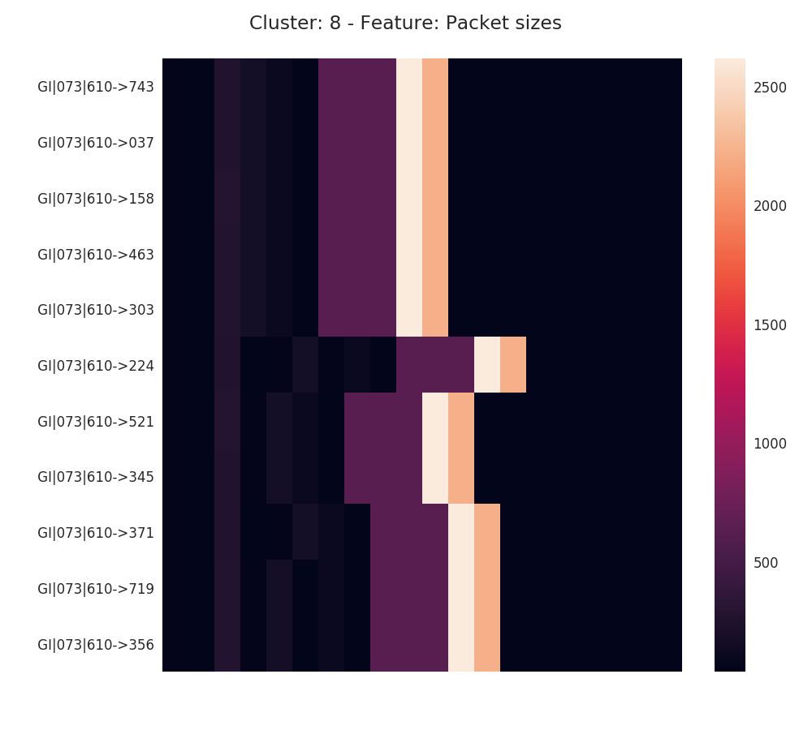
Use heatmaps to visualize groups
Row = connection
Column = time
Cell = Bytes transfered

Slide 48
These are all Data Mining skills
We take data as is, but select features using domain knowledge
learning
algorithm
model
train data

Slide 49
These are all Data Mining skills
We cluster using clustering approaches
We take data as is, but select features using domain knowledge
learning
algorithm
model
train data

Slide 50
These are all Data Mining skills
We cluster using clustering approaches
and make the results (gained knowledge) insightful using heatmaps
We take data as is, but select features using domain knowledge
learning
algorithm
model
train data
output

Slide 51
Why is it hard ?
Volume
Velocity
Variety

Slide 52

Why is it hard ?
Volume
Velocity
Variety
Need scalable algorithms

Slide 53

Why is it hard ?
Volume
Velocity
Variety
Need approximate yet accurate estimates

Slide 54



Why is it hard ?
Volume
Velocity
Variety
Adapt to different datatypes, distributions, ..

Slide 55
COURSE CONTENT
Notes:
This is just an overview, not the same order as the course

Slide 56
Distances, Matrices, Counting
Distances
Matrices
Counting
Similarity
Metrics
Computation
DTW
Text Embeddings
Graph Embeddings
Representation
Properties
Operations
Factorization
Decompositions
Dimensionality red.
Hashing
Clustering
Anomaly detection
Sketching

Slide 57






Distances, Matrices, Counting
Distances
Similarity
Metrics
Computation
DTW
Text Embeddings
Graph Embeddings

Slide 58

Distances, Matrices, Counting
Matrices
data
Representation
Properties
Operations
Factorization
Decompositions
Dimensionality red.
=

Slide 59




Distances, Matrices, Counting
Counting
Hashing
Clustering
Anomaly detection
Sketching

Slide 60
A word of caution

Slide 61
Don’t fool yourself

Slide 62
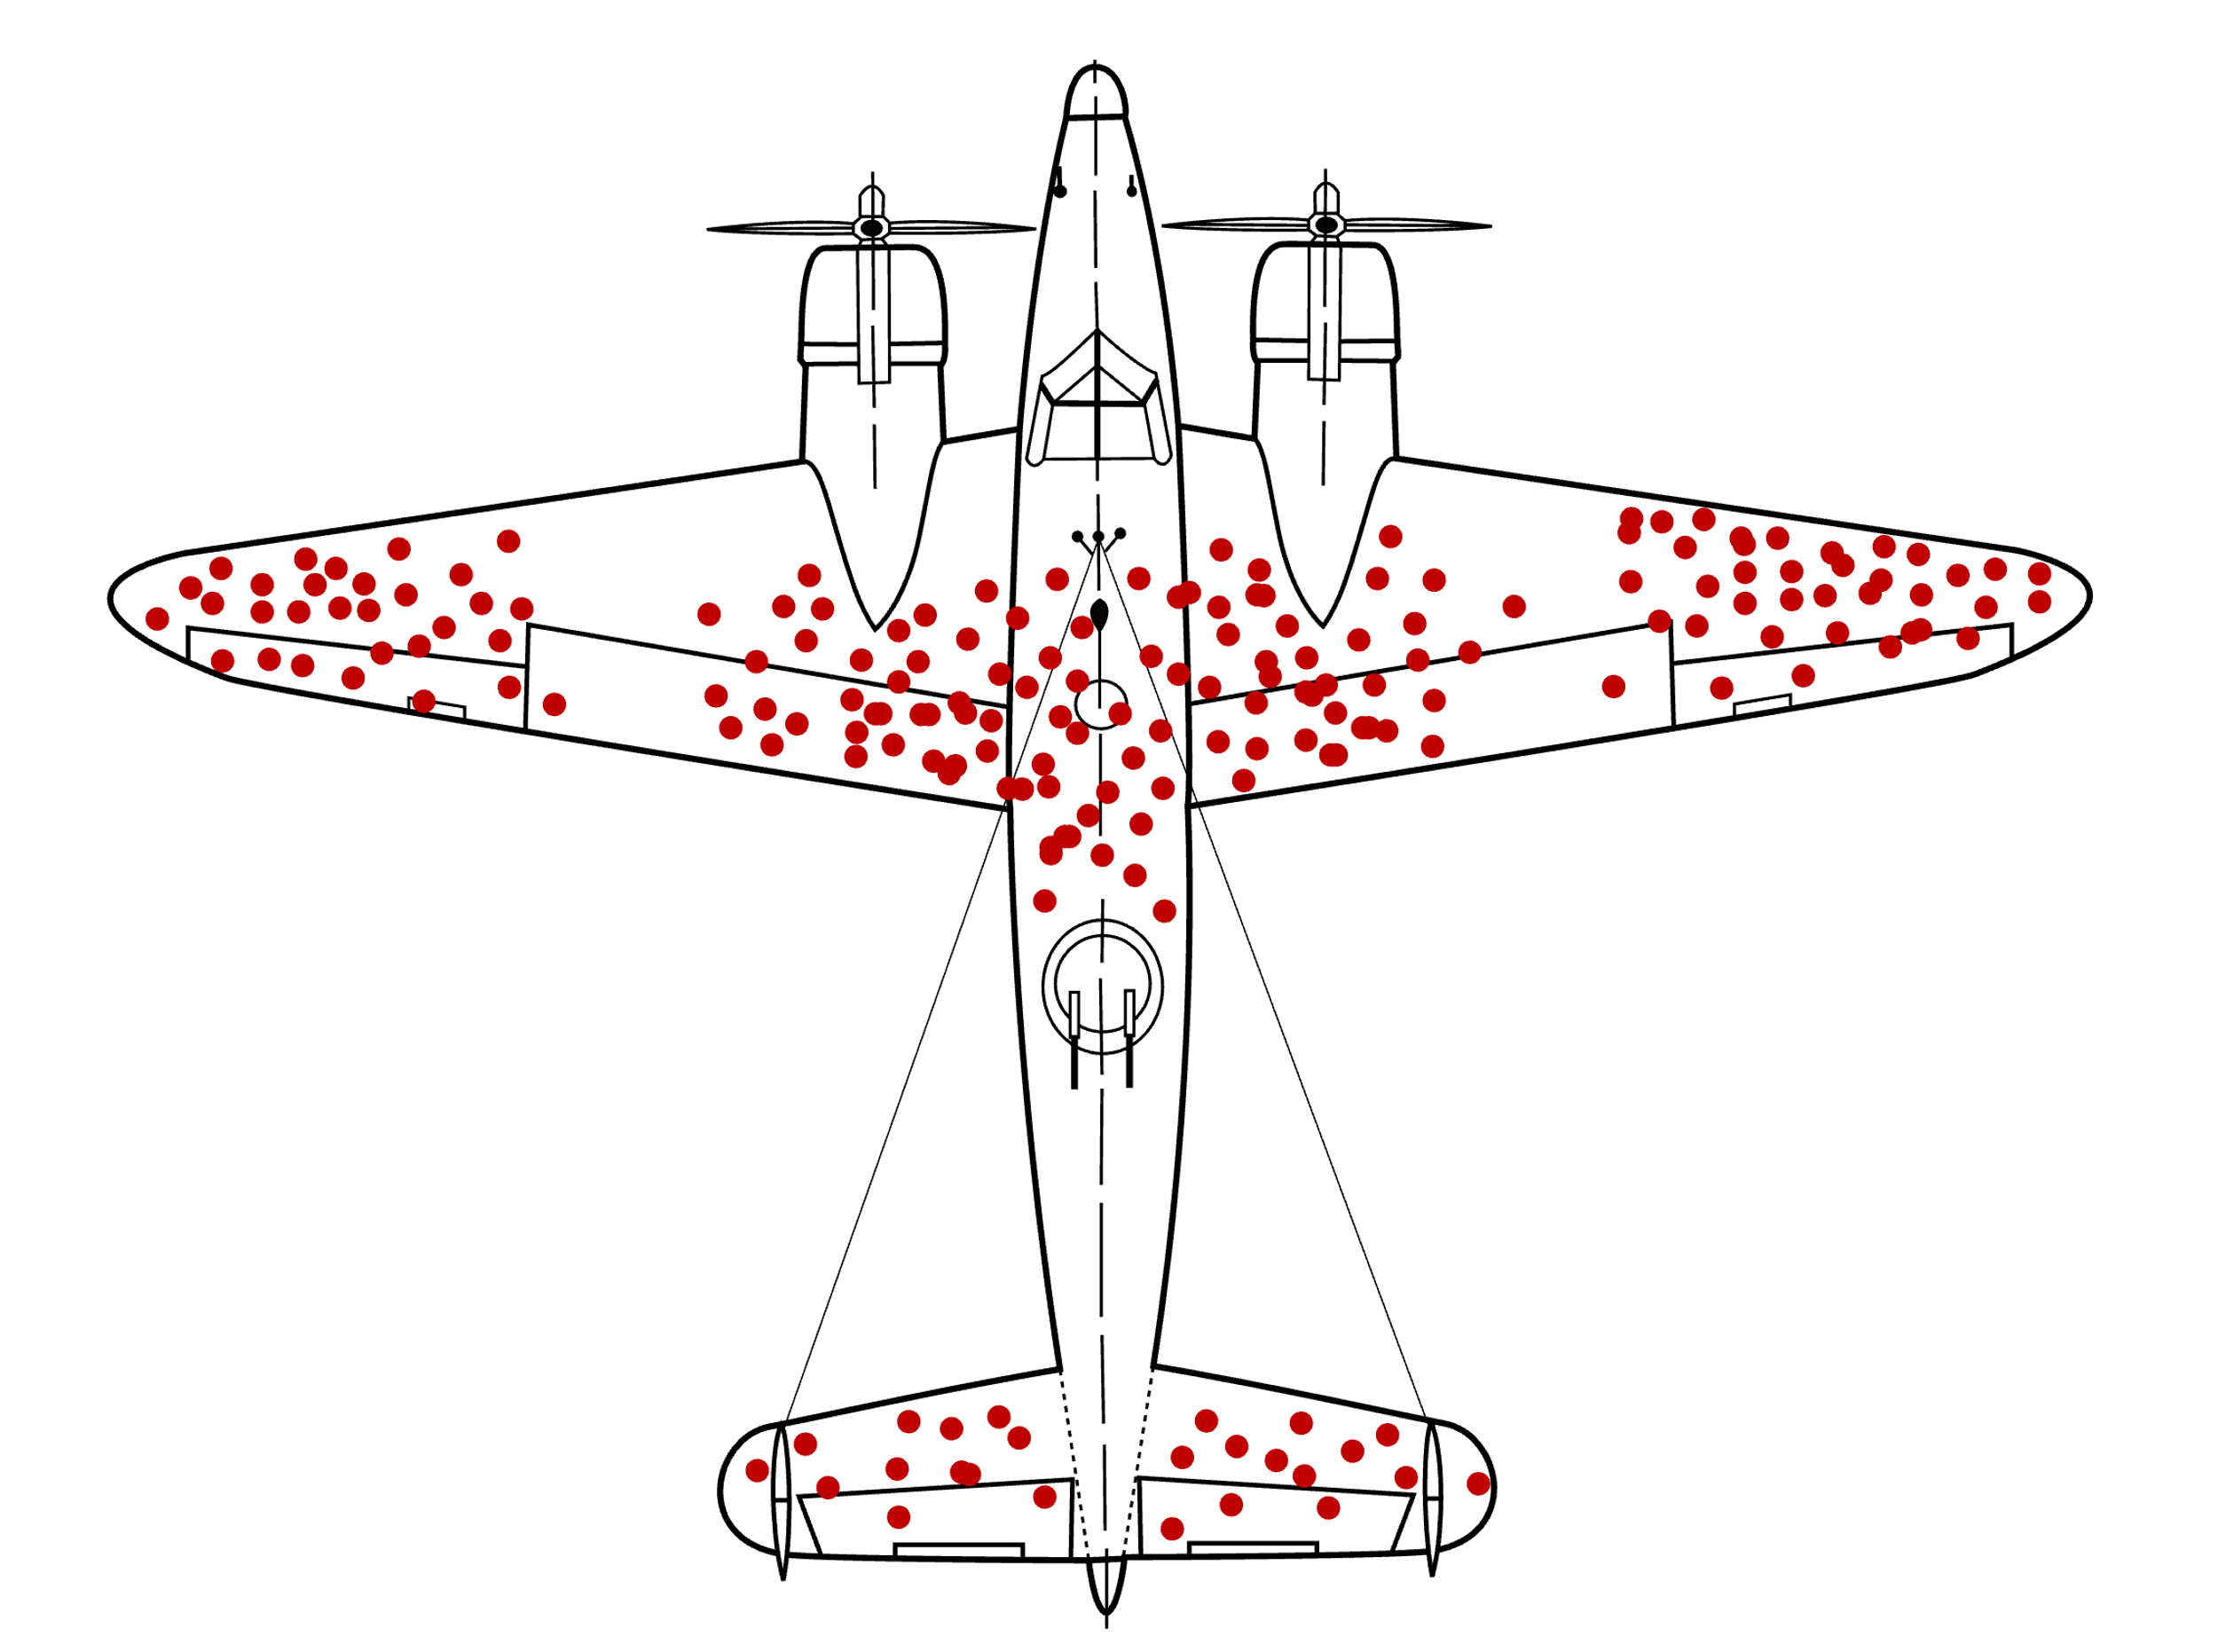
Where should you reinforce the airplane ?

Slide 63
Survivorship bias

Slide 64
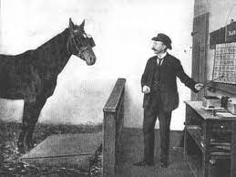
The Clever Hans Effect

Slide 65
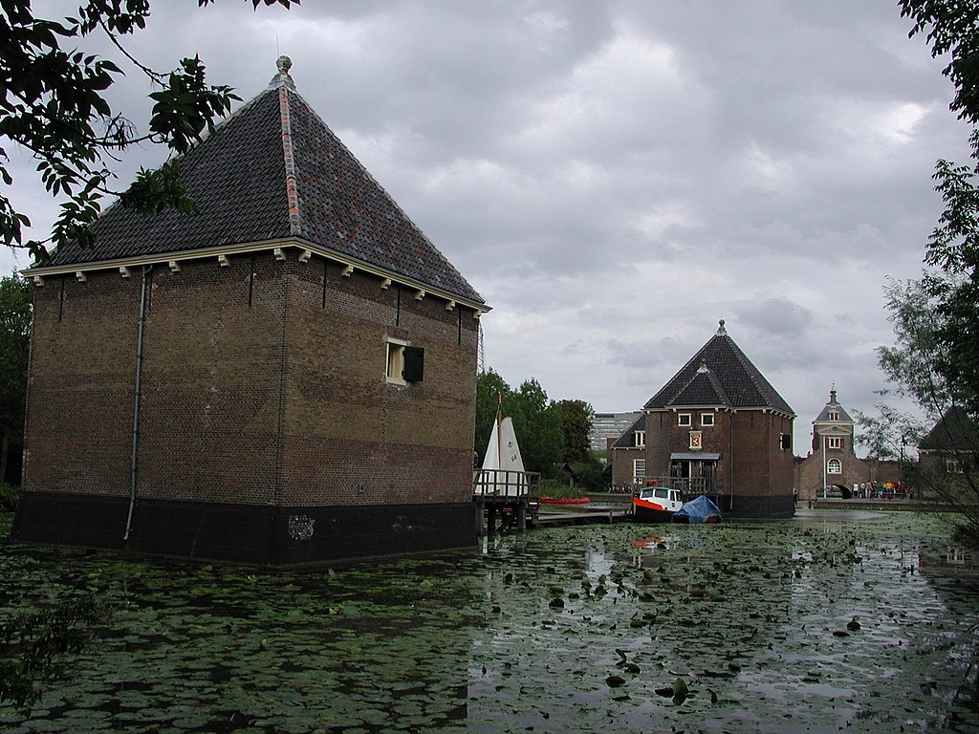
Citations in Wikipedia
The gunpowder store (Dutch: Kruithuis) was subsequently re-housed, a 'cannonball's distance away', outside the city, in a new building designed by architect Pieter Post.^{[14]}

Slide 66
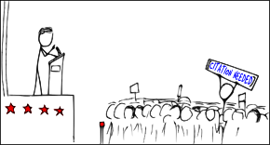
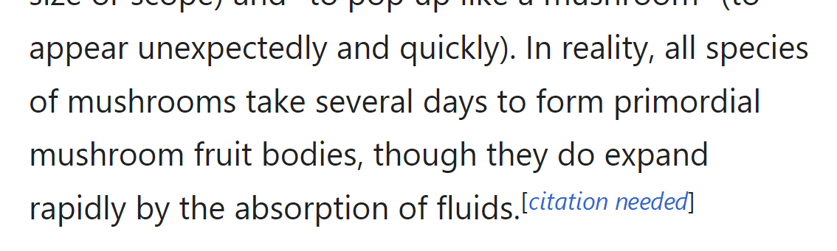
Citation needed in Wikipedia

Slide 67
Citations in Wikipedia
The gunpowder store (Dutch: Kruithuis) was subsequently re-housed, a 'cannonball's distance away', outside the city, in a new building designed by architect Pieter Post. ^{[14]}
Delft University of Technology (TU Delft) is one of four universities of technology in the Netherlands. ^{[23]}
It was founded as an academy for civil engineering in 1842 by King William II.
Today, well over 21,000 students are enrolled. ^{[24]}

Slide 68
How can we automatically provide citations for Wikipedia
The neural network was trained, and was 100% accurate on the test set
What should you be asking yourself ?
Its too good to be true

Slide 69
Citations in Wikipedia
The gunpowder store (Dutch: Kruithuis) was subsequently re-housed, a 'cannonball's distance away', outside the city, in a new building designed by architect Pieter Post. ^{[14]}
The gunpowder store (Dutch: Kruithuis) was subsequently re-housed, a 'cannonball's distance away', outside the city, in a new building designed by architect Pieter Post.
Delft University of Technology (TU Delft) is one of four universities of technology in the Netherlands. ^{[23]}
It was founded as an academy for civil engineering in 1842 by King William II.
Today, well over 21,000 students are enrolled. ^{[24]}
Delft University of Technology (TU Delft) is one of four universities of technology in the Netherlands.
It was founded as an academy for civil engineering in 1842 by King William II.
Today, well over 21,000 students are enrolled.

Slide 70
How can we automatically provide citations for Wikipedia
The neural network was trained, and was 100% accurate on the test set
When asked humans – they were < 55% accurate

Slide 71
Shortcuts in Learning
The gunpowder store (Dutch: Kruithuis) was subsequently re-housed, a 'cannonball's distance away', outside the city, in a new building designed by architect Pieter Post.
The gunpowder store (Dutch: Kruithuis) was subsequently re-housed, a 'cannonball's distance away', outside the city, in a new building designed by architect Pieter Post. ^{[14]}
Delft University of Technology (TU Delft) is one of four universities of technology in the Netherlands.
It was founded as an academy for civil engineering in 1842 by King William II.
Today, well over 21,000 students are enrolled.
Delft University of Technology (TU Delft) is one of four universities of technology in the Netherlands. ^{[23]}
It was founded as an academy for civil engineering in 1842 by King William II.
Today, well over 21,000 students are enrolled. ^{[24]}
If ." " predict citation needed

Slide 72
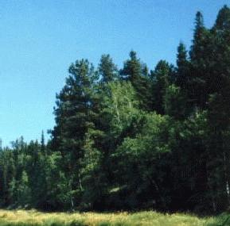
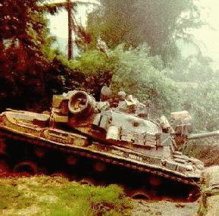
Russian Tanks
After much analysis, it turned out the network implemented the following:
If the sky is blue, there is no tank
otherwise there is
The neural network was trained, and was 100% accurate on the test set
When tested on another data set, the network performed worse then random guessing…

Slide 73
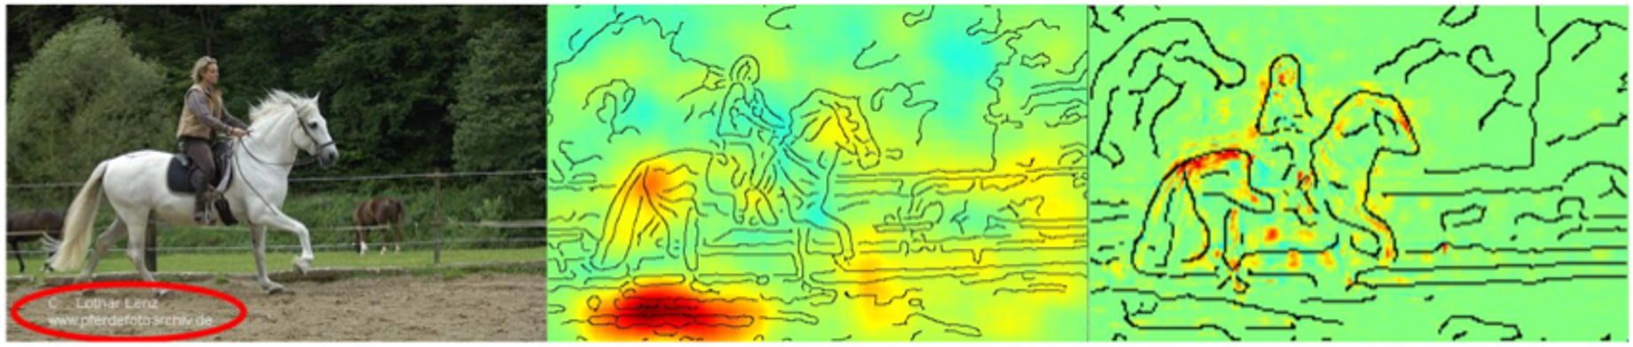
Shortcuts in image models
horse

Slide 74
Shortcuts in image models
If "copyright" predict horse

Slide 75

You can always find what you are looking for

Slide 76
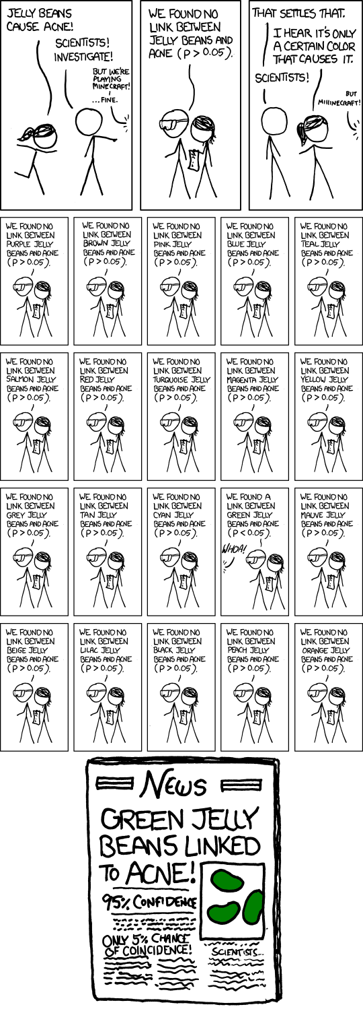

Slide 77
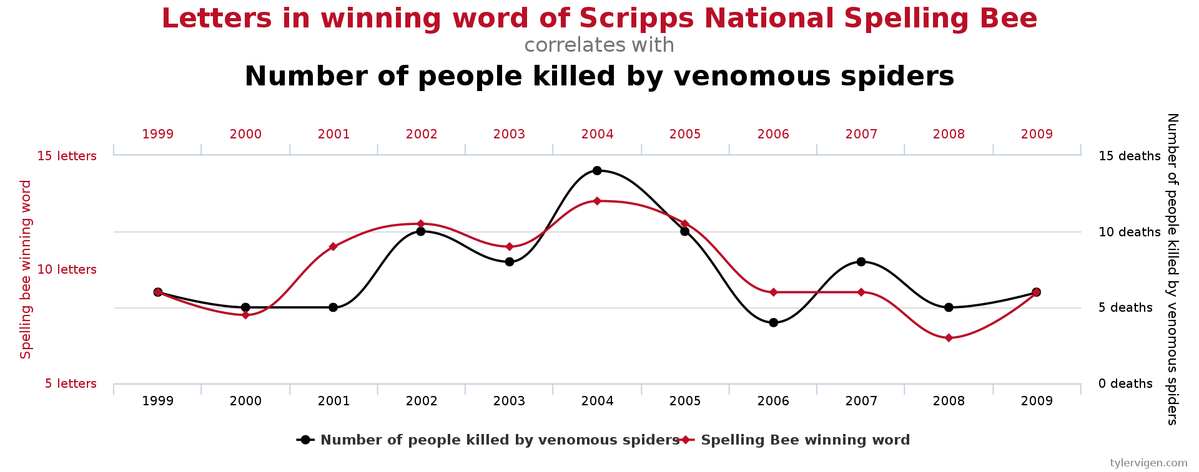
Multiple Comparisons Problem
The cause of many errors in data mining…
https://youtu.be/HpjlcEH4zuY?si=3-KnR06RHipLk_UK

Slide 78
Summary
Data Mining: Extract useful information from a large volume of data and transform it into an understandable structure
Labs 30% (3 of them), Final exam 70%, Homeworks as examples for finals (6 of them)
Content organization: Distances, Matrices, Counting
Data mining as the skill of the 21st century
But tread with caution

